Slide 1
Generate Insights to Solve a Supply Chain Issue in the FMCG domain
RPC #2

Slide 2
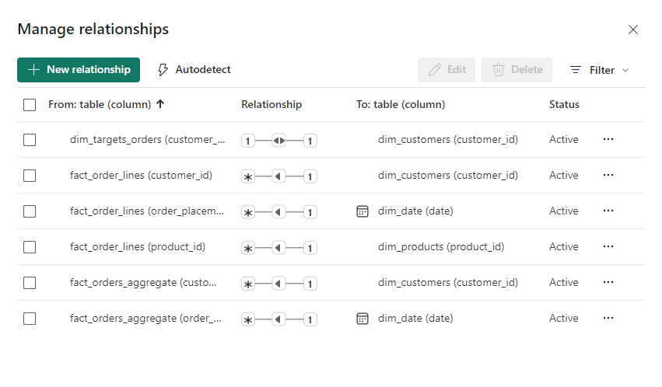
Data Modeling - Relationships

Slide 3
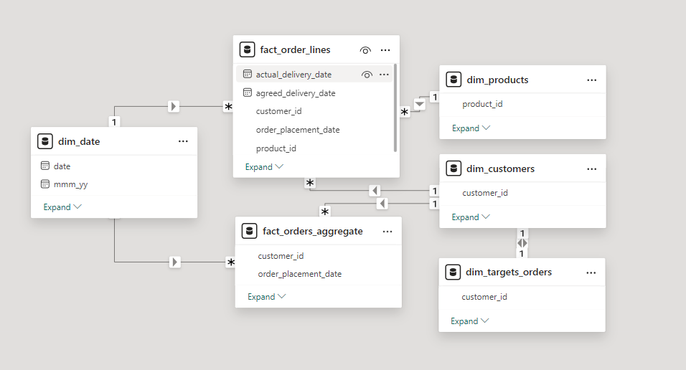
Data Modeling

Slide 4


Report
Live Report

